Slide 1
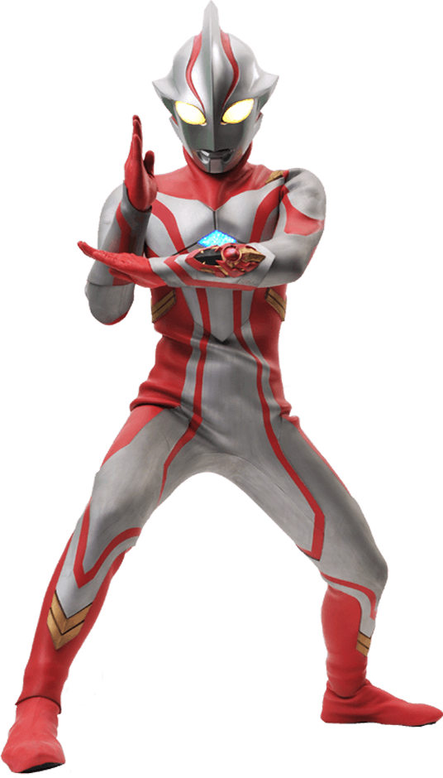
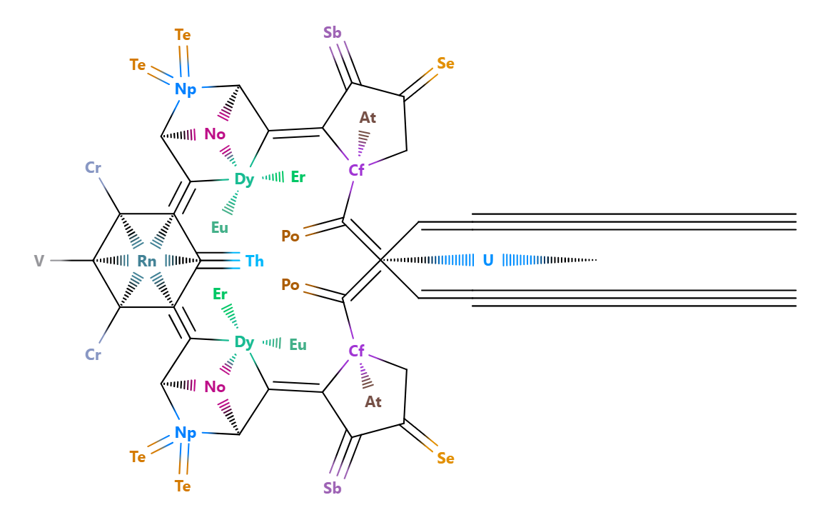







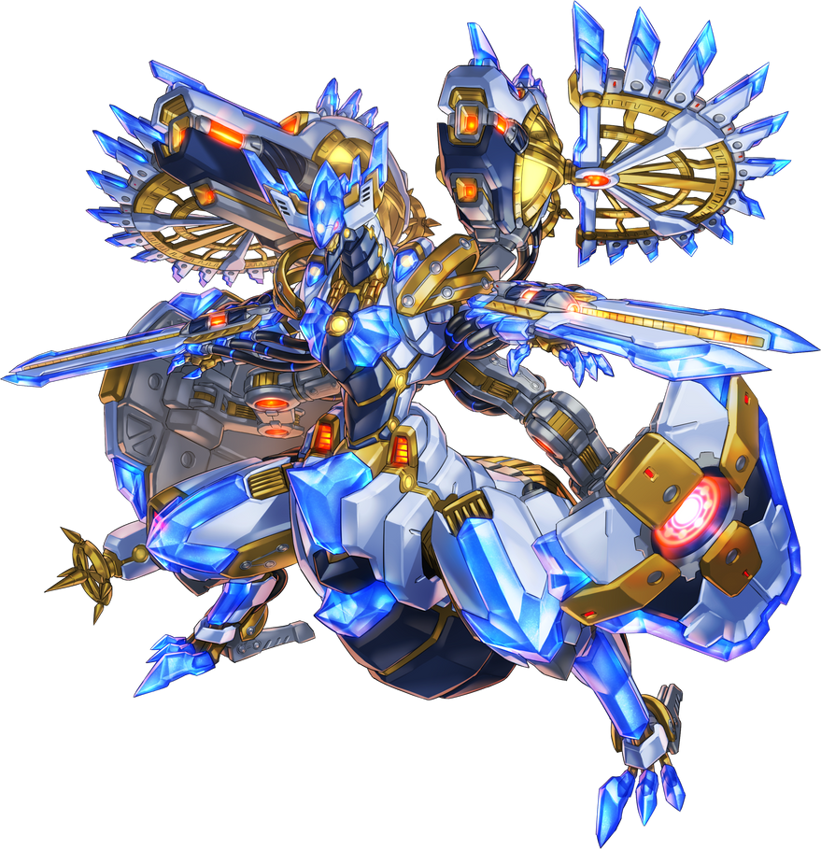


Sup
Programming
Organic Chemistry
Geometry
Graphic Design
Music Composition
Linguistics
Yu-Gi-Oh!
Creative Writing
I’m a nerdier nerd
I have too many interests
I love creating and naming things
I browse Wikipedia in my free time
I overthink stuff
I type fast
Also, I live really far away
I call this a Beta Uranium Railgun.
create struct 'accelerator' {
evolve self.create(ctx) [
| 'topEnergy' [int] = 700
| 'product' [pool[protons, neutrons]] = slot:neutrons
] {
self.autoset()
}
}

Slide 2
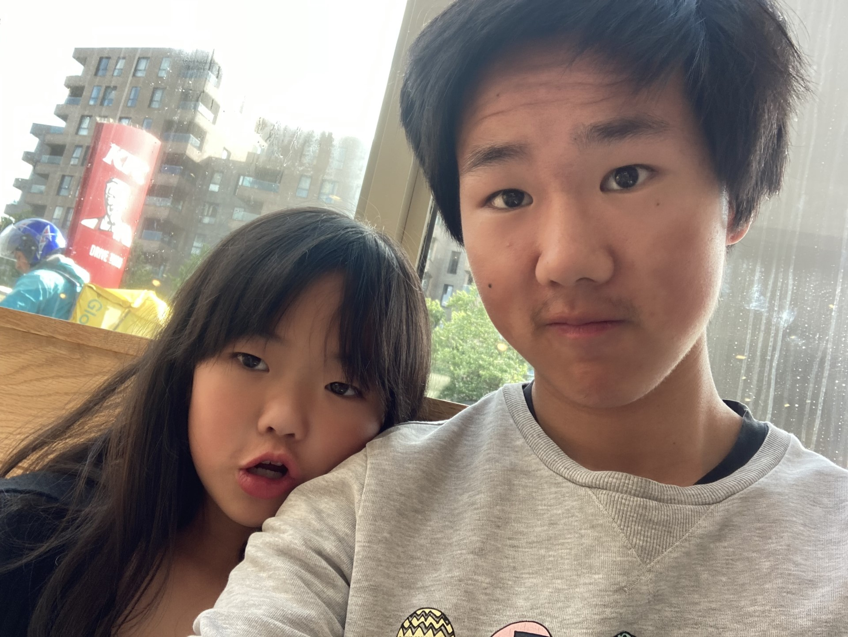
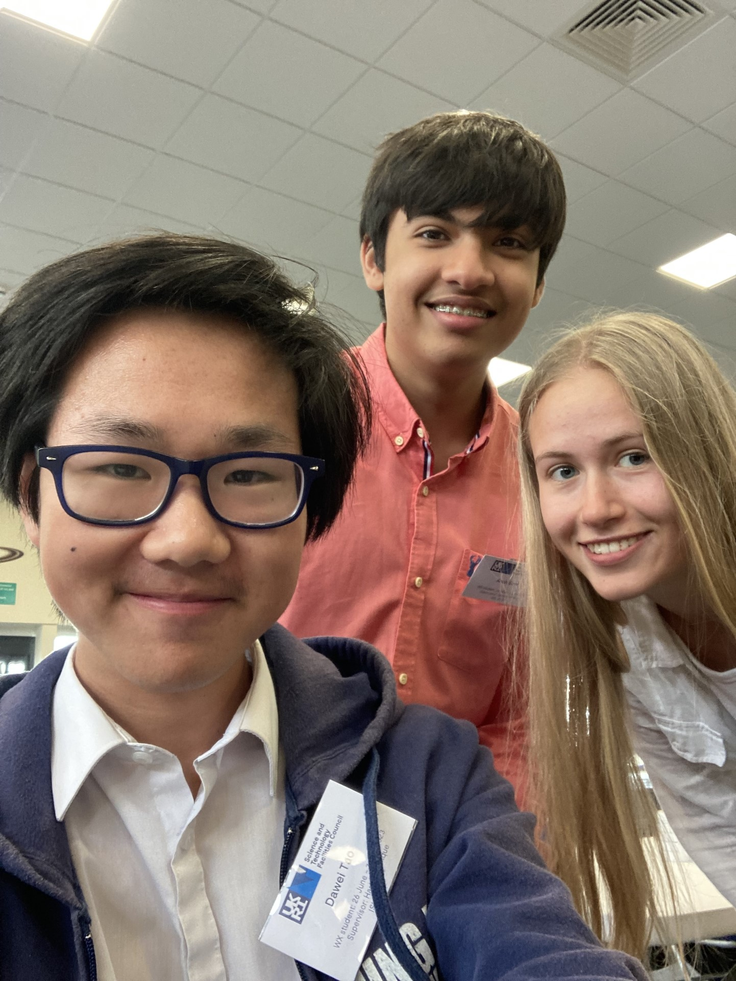
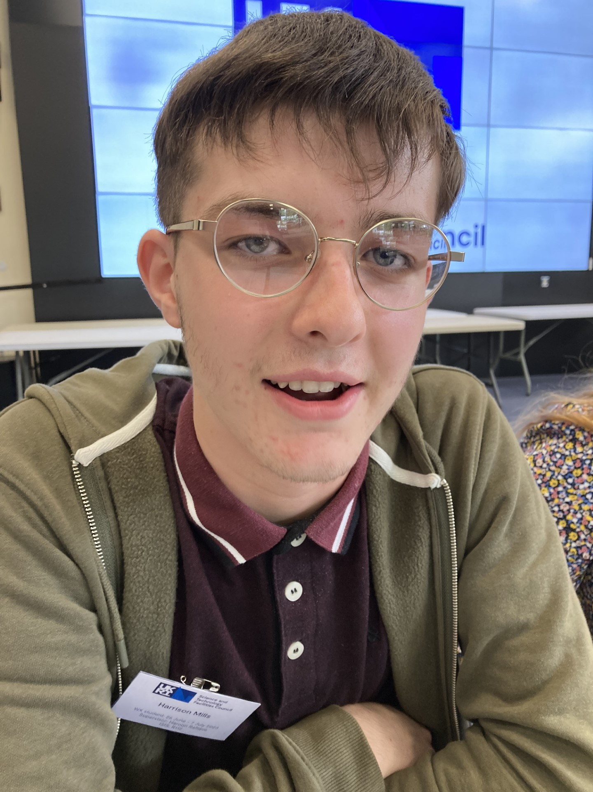
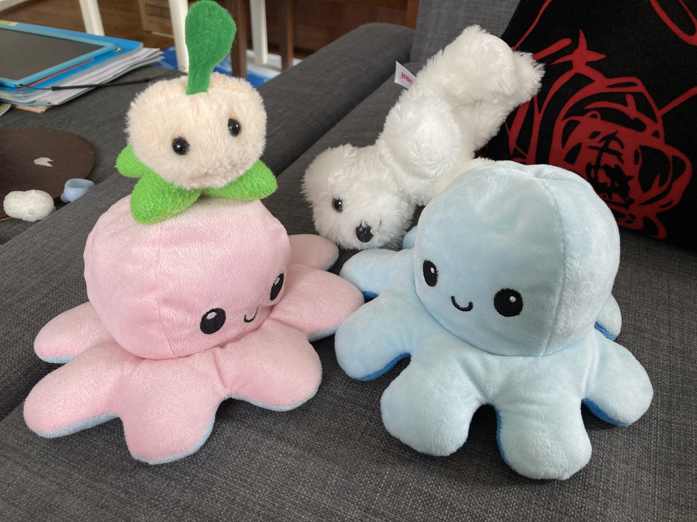
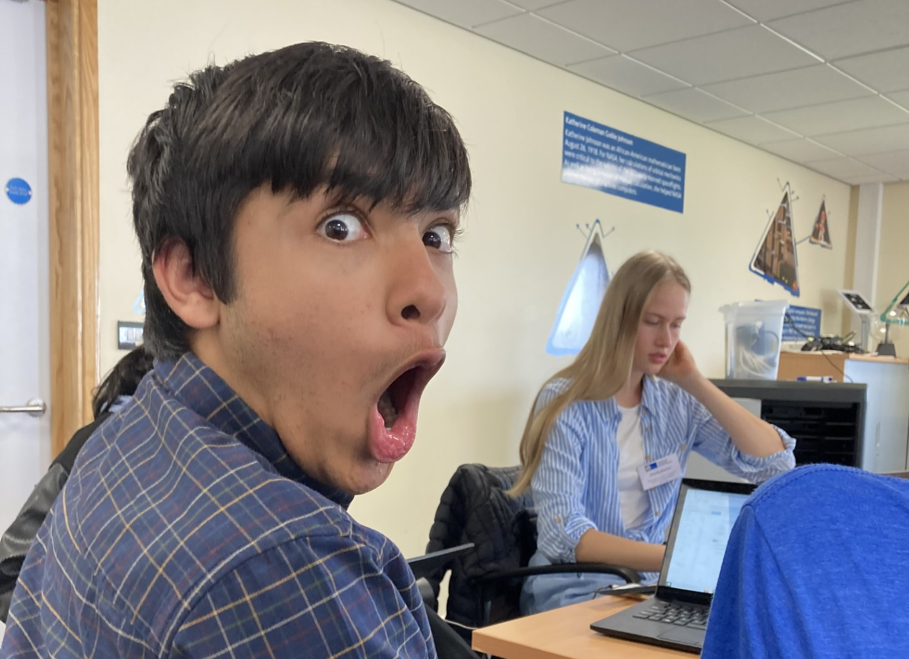

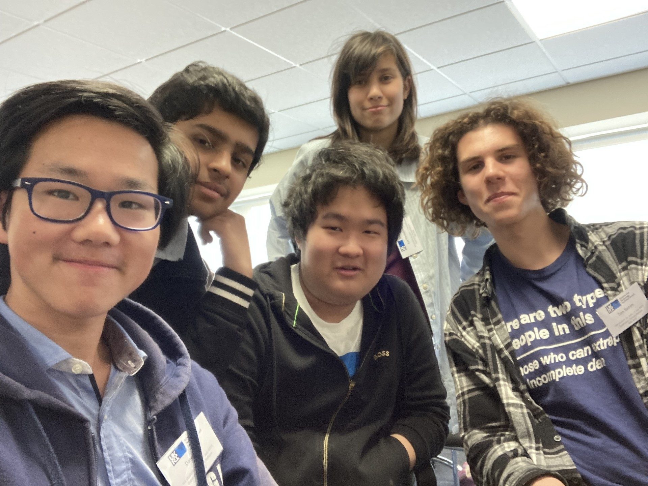

Slide 3
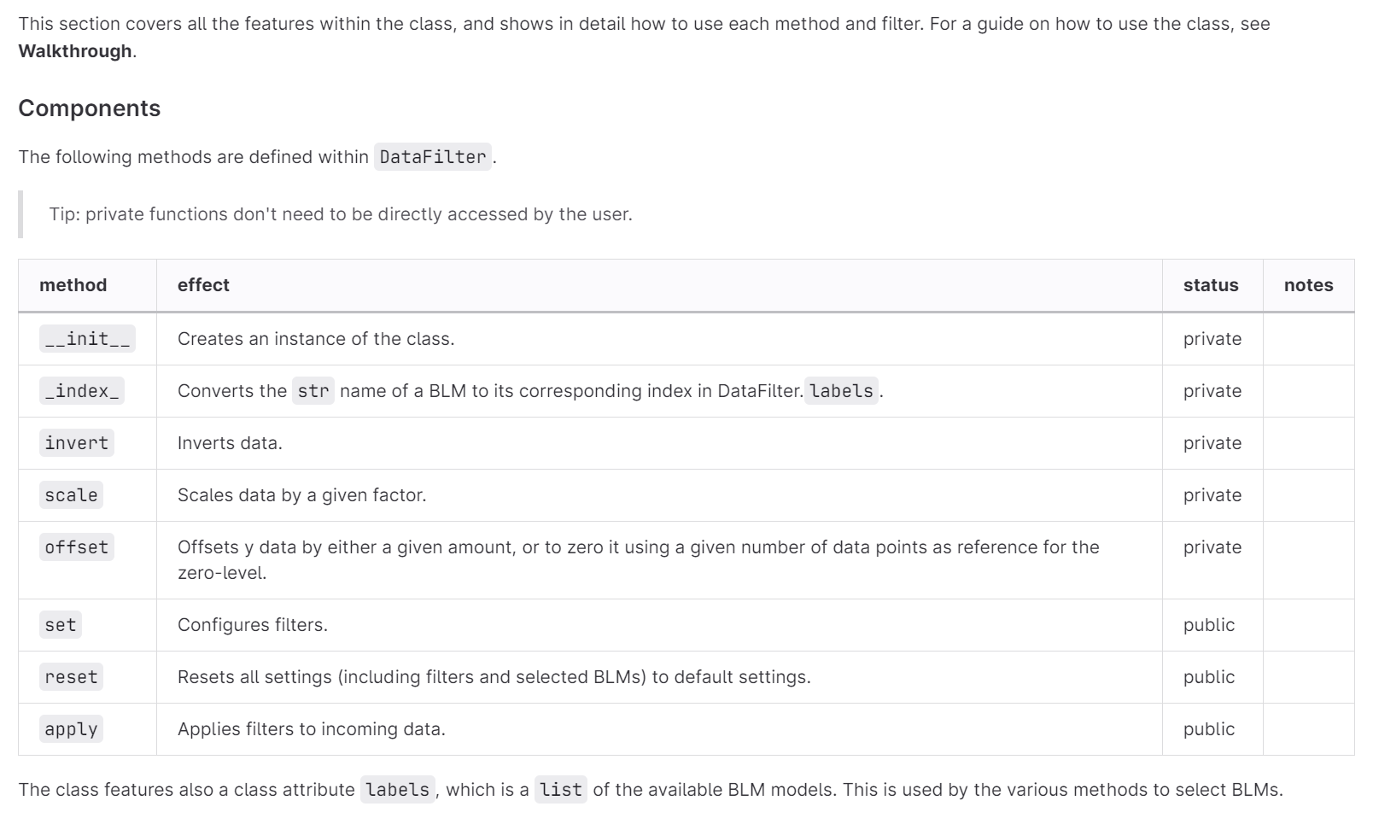
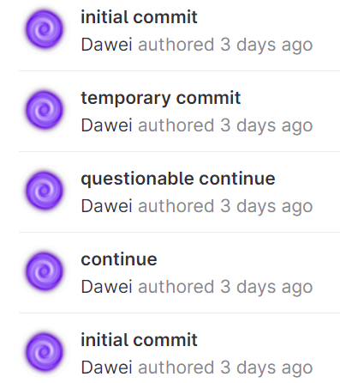
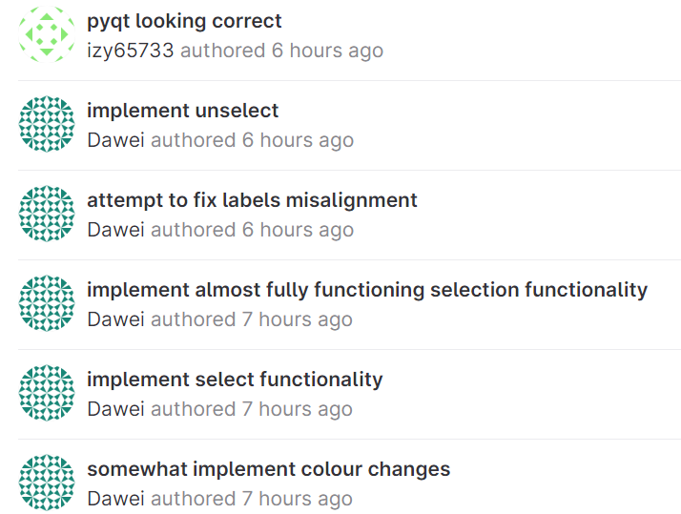
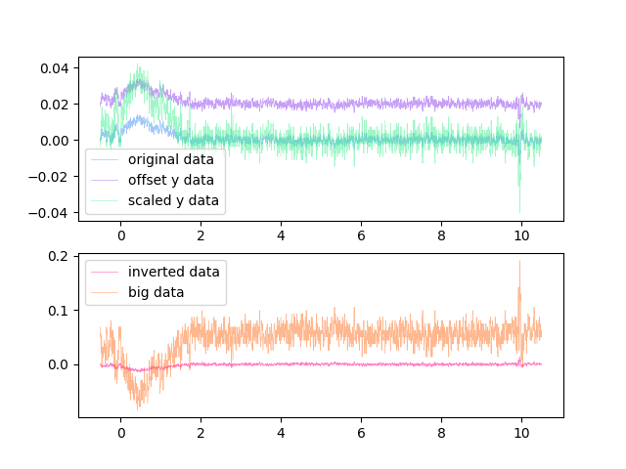
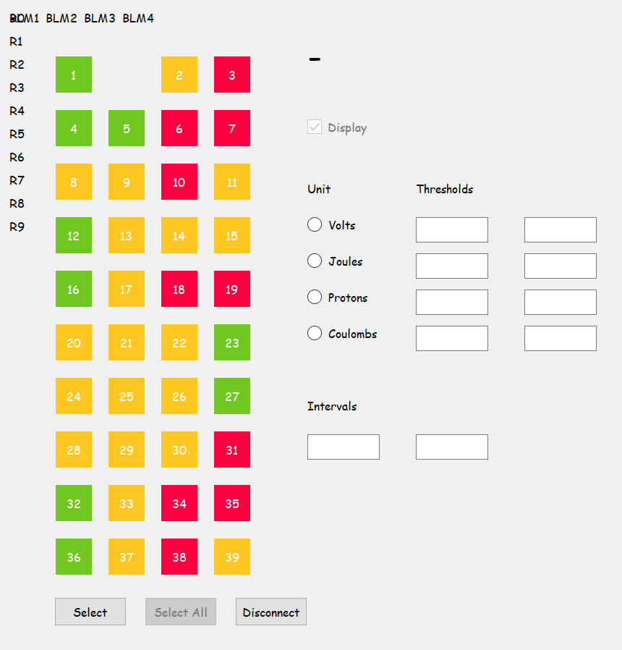
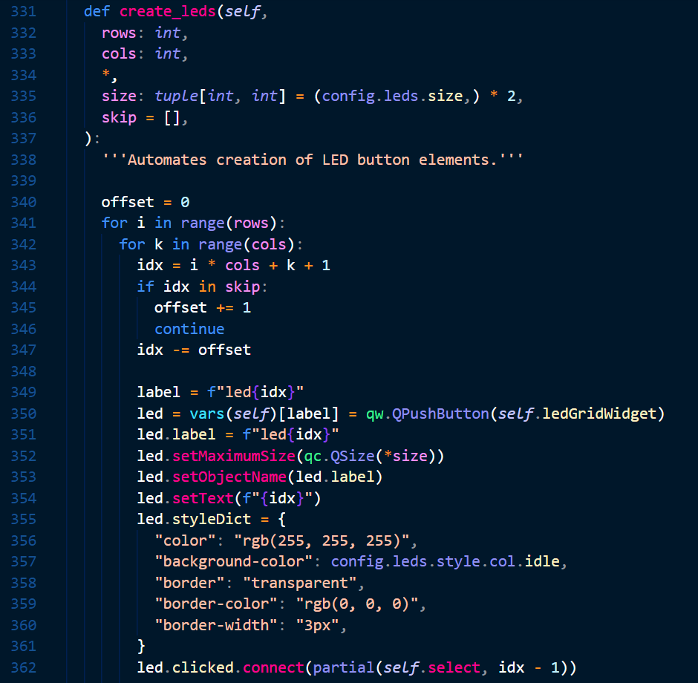
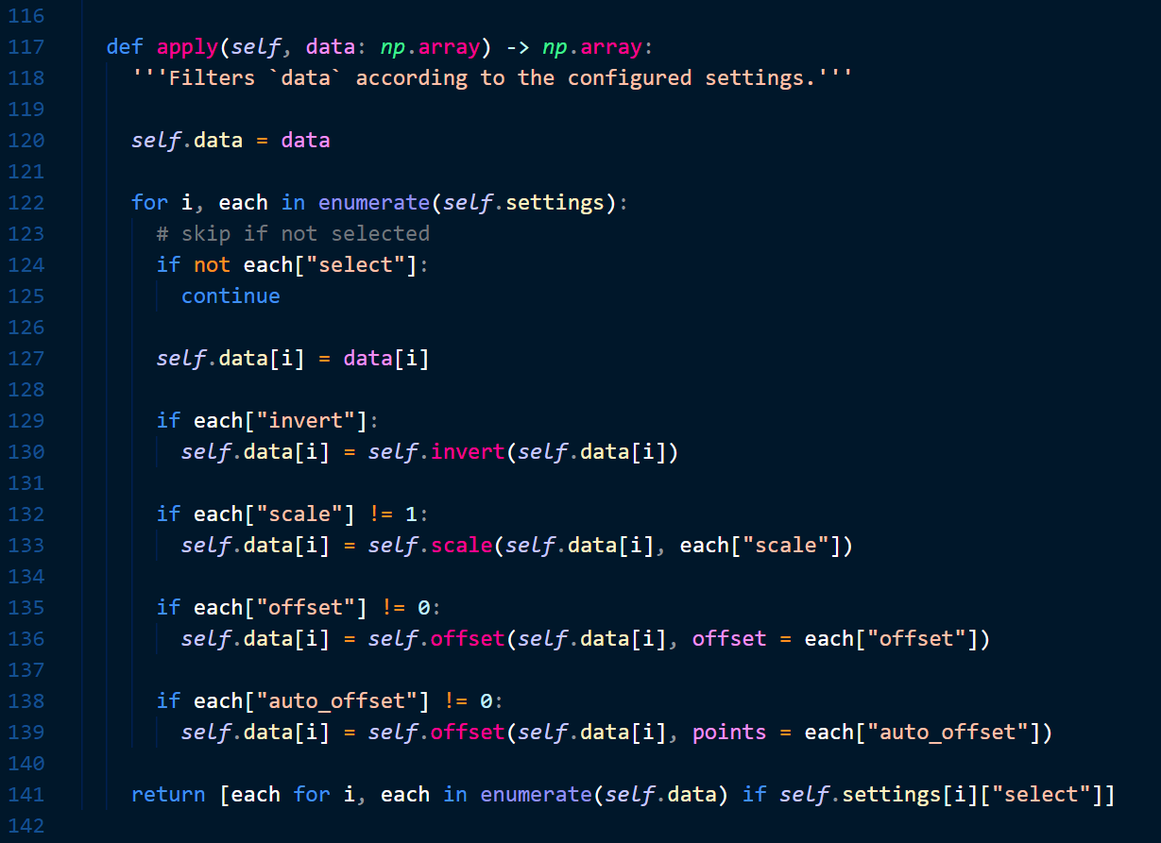
Stage 1 – Data Filtering
Stage 2 – LED Display
Ansh, Charlize
Notes:
tied work together in a class,
documentation
collaboration is hard, both as difficult and harder than I expected
never gonna give this up

